Slide 1
Secure Data Hiding In Images Using Steganography
CAPSTONE PROJECT
Presented By:
Rahul Jain
College Name & Department:
CV Raman Global University, Computer Science & Engineering

Slide 2
OUTLINE
Problem Statement
Technology used
Wow factor
End users
Result
Conclusion
Git-hub Link
Future scope

Slide 3
Problem Statement
Need for sending confidential data within images by encrypting it with strong algorithms with a password protecting decryption mechanism by maintaining the integrity of the image, so that its hard for the intruder to get the message

Slide 4
Technology used
Programming Language: Python
Image Processing Library: OpenCV
File Handling & Security: Basic encryption logic for password protection
Additional Libraries: Pillow (for image handling)
Platform: Windows 11

Slide 5
Wow factors
Uses steganography to embed a message into an image without noticeable changes as it uses LSB instead of MSB.
Lossless data hiding using pixel value manipulation instead of traditional cryptographic techniques.
Works on any standard image file format.

Slide 6
End users
Cybersecurity Enthusiasts – Exploring secure communication techniques.
Government & Defense – Secure message transmission without raising suspicion.
Journalists & Activists – Concealing sensitive information in images to avoid surveillance.

Slide 7
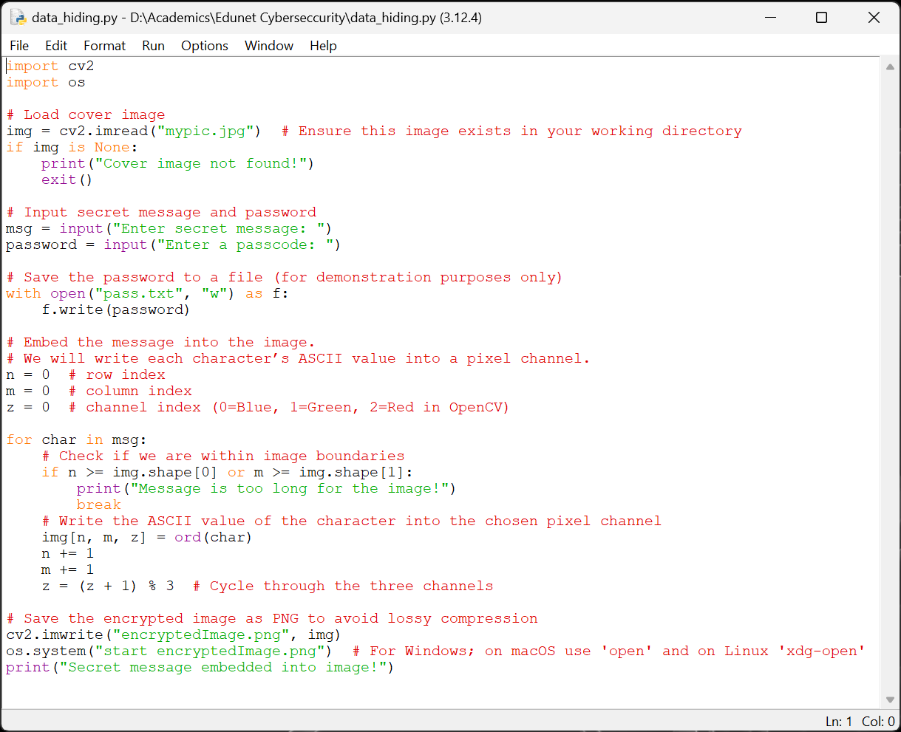
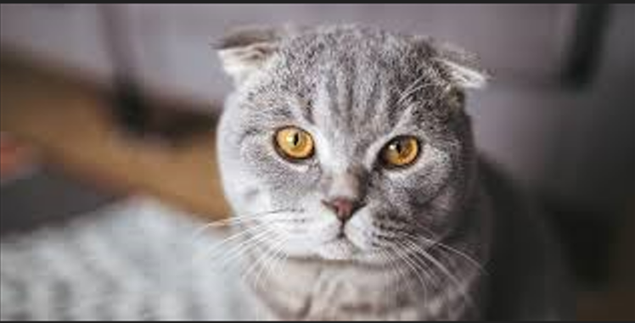
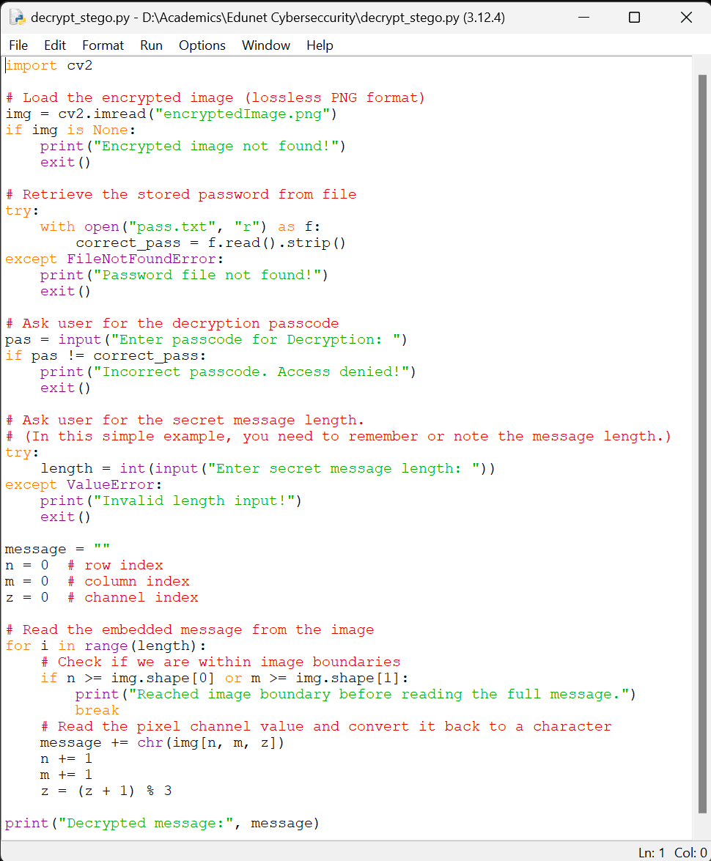
Results
Encryption Code:
Input Image File:
Decryption Code:
Output Image File:

Slide 8
Conclusion
Steganography provides a covert way of communicating sensitive information.
This project showcases a simple yet effective implementation of message hiding in images.
Future improvements can make it more robust, secure, and scalable.

Slide 9
GitHub Link
https://github.com/the-pure-soul/My_Steganography_Project.git

Slide 10
Future scope
Advanced Encryption Techniques – Integrate AES encryption before embedding text in images.
Support for Audio & Video Steganography – Expanding beyond images.
AI-based Detection Prevention – Ensuring messages stay undetectable from modern forensic tools.
Mobile App & Web Version – Expanding accessibility beyond desktops.
Multi-Layer Security – Combining steganography with blockchain for ultra-secure communication.

Slide 11
THANK YOU

